Slide 1


HYBRID VEHICLE ENERGY RECOVERY SYSTEM
“Energy can neither be created nor be destroyed”
TECH REGENERATION

Slide 2

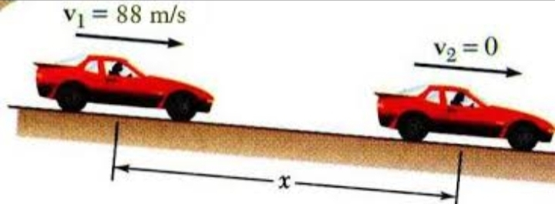
TOPIC: Energy efficiency in a hybrid vehicle
REASON TO CHOOSE THIS PROBLEM:
Majority of the modern cars are Combustion engine vehicles it leaves us to rely on these technology for coming years . Hence these needed to be more efficient in using the energy. These modern vehicles are around 40% efficient in the usage of their fuel . This can be due to large amount energy being wasted through heat and braking. This can be changed using certain aspects of technology and energy concepts.
BRAKING ENERGY WASTAGE
EXHAUST ENERGY WASTAGE

Slide 3
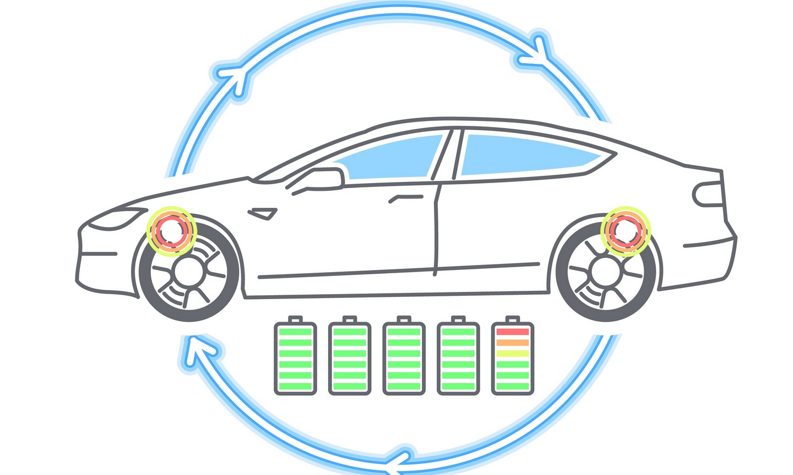
Framework of solution
Law of conservation of Energy
The vehicle utilizes the fuel provided to burn it and gain kinetic energy . kinetic energy possessed by the vehicle is reduced to heat energy on the brake disk . Instead of the kinetic energy of the vehicle being wasted as heat and friction the vehicle could utilize the kinetic energy to turn the turbine of a generator which could help to create electrical energy which could be stored in a battery
Here also a large amount of heat energy is wasted by blowing it through exhaust pipe instead it can be utilized as steam which will help in rotating the turbine of a generator to produce electrical energy which will be stored in a battery.

Slide 4
GENERAL DESIGN OF SOLUTION:
SIMULATION OF THE VEHICLE:
The energy recovery system schematic diagram which includes the
braking mechanical components ,electrical requirements ,
the steam generator, the motor generator unit , and the IC engine.
WORKING OF THE SYSTEM:
The working of the energy recovery system utilizing the exhaust gas
and braking along with the physics involved for the implementation.

Slide 5
SIMULATION DESCRIPTION:
BLOCK DIAGRAM:
Drive controller
Fuel
ICE
DC Motor Unit
Exhaust Unit
vehicle body
Steam Generator
Power converter
Battery

Slide 6
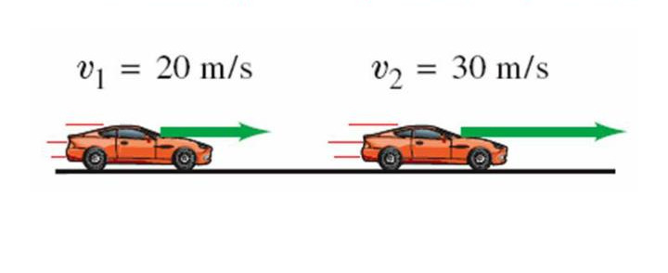
WORKING:
1.MOTION OF A VEHICLE:
The driver press the accelerometer to give power to drive shaft , the driver input is managed by the driver controller which precisely creates exact amount of power needed using the DC motor and the IC engine. This turns the wheels and move the vehicle with a particular velocity . This vehicle in motion possesses a certain amount of kinetic energy.
K.E=1/2 mv**2
This kinetic energy will be used to overcome the frictional force and the air resistance . Hence to maintain a constant velocity continuous power is to be supplied . Then when the vehicle comes to stop the kinetic energy possessed is lost by the vehicle.

Slide 7
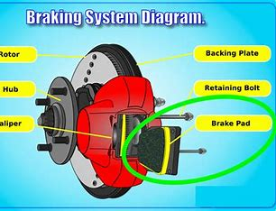
2. BRAKING:
The driver when intends to stop the vehicle or slow down , the velocity drops down and simultaneously the kinetic energy too. The kinetic energy possessed before is then converted heat energy at the brake disk caused by friction . The fuel consumed to attain the kinetic energy is then transferred to the environment as heat energy and thereby reducing the efficiency of the fuel consumed. This mechanism is mechanically controlled by the driver using the brake pedal.
The disk temperature might reach up to 700 degree Celsius . The brake input can be controlled using ABS.

Slide 8
3.FUEL INJECTION and EXHAUST:
The fuel is injected on the basis of throttle input given by the driver controller and on the basis of the management of the power from the ICE and DC motor to the drive shaft . The fuel is injected as a mixture with air in spark ignition and just fuel in the compression ignition engines . The fuel from the tank is regulated using valves. The fuel is then burned and mechanical energy is produced through the crank shaft. This is then transferred to the drive shaft through the transmission.
The burned fuel is then released through the exhaust valve to the exhaust pipe from where the gas is released into the environment . The exhaust gas can reach up to 500 degree Celsius .Exhaust when not handled properly are extremely dangerous to the environment.

Slide 9
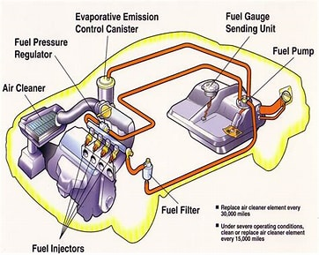
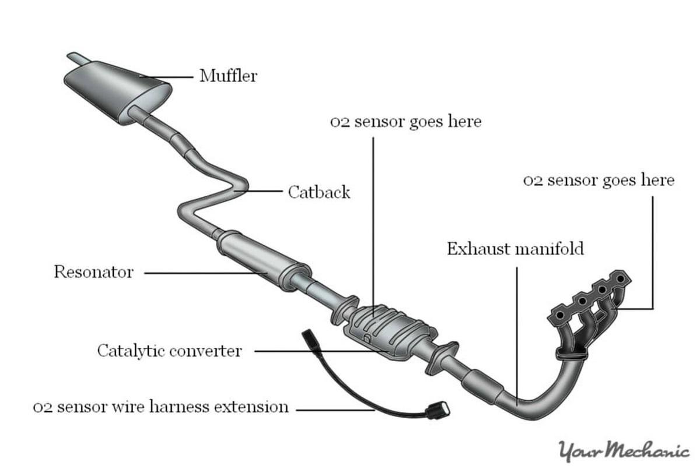
FUEL INJECTION SYSTEM
EXHAUST GAS SYSTEM

Slide 10
4. POWER CONVERTER-H BRIDGE:
The drive shaft of the vehicle body is connected to the power controller which along with the H-bridge and two motors act as a motor generator unit(MGU) . When the throttle input is given to the DC motor to attain Kinetic energy the power controller directs the power from the battery to the DC motor which along with IC engine can generate acceleration . When decelerating the power controller switches the direction of torque(braking torque).This torque will act as brake and the Kinetic energy possessed by the vehicle is then transferred through the MGU to the battery itself . Thereby reducing the wastage of energy in the form of heat using friction braking . The braking torque may not always be sufficient to decelerate the vehicle hence provided with a brake disk in case of need . The kinetic energy possessed by the utilisation of all the power units is come to zero when stopping , let the kinetic energy before decelerating be:
K.E. = ½ mv2

Slide 11
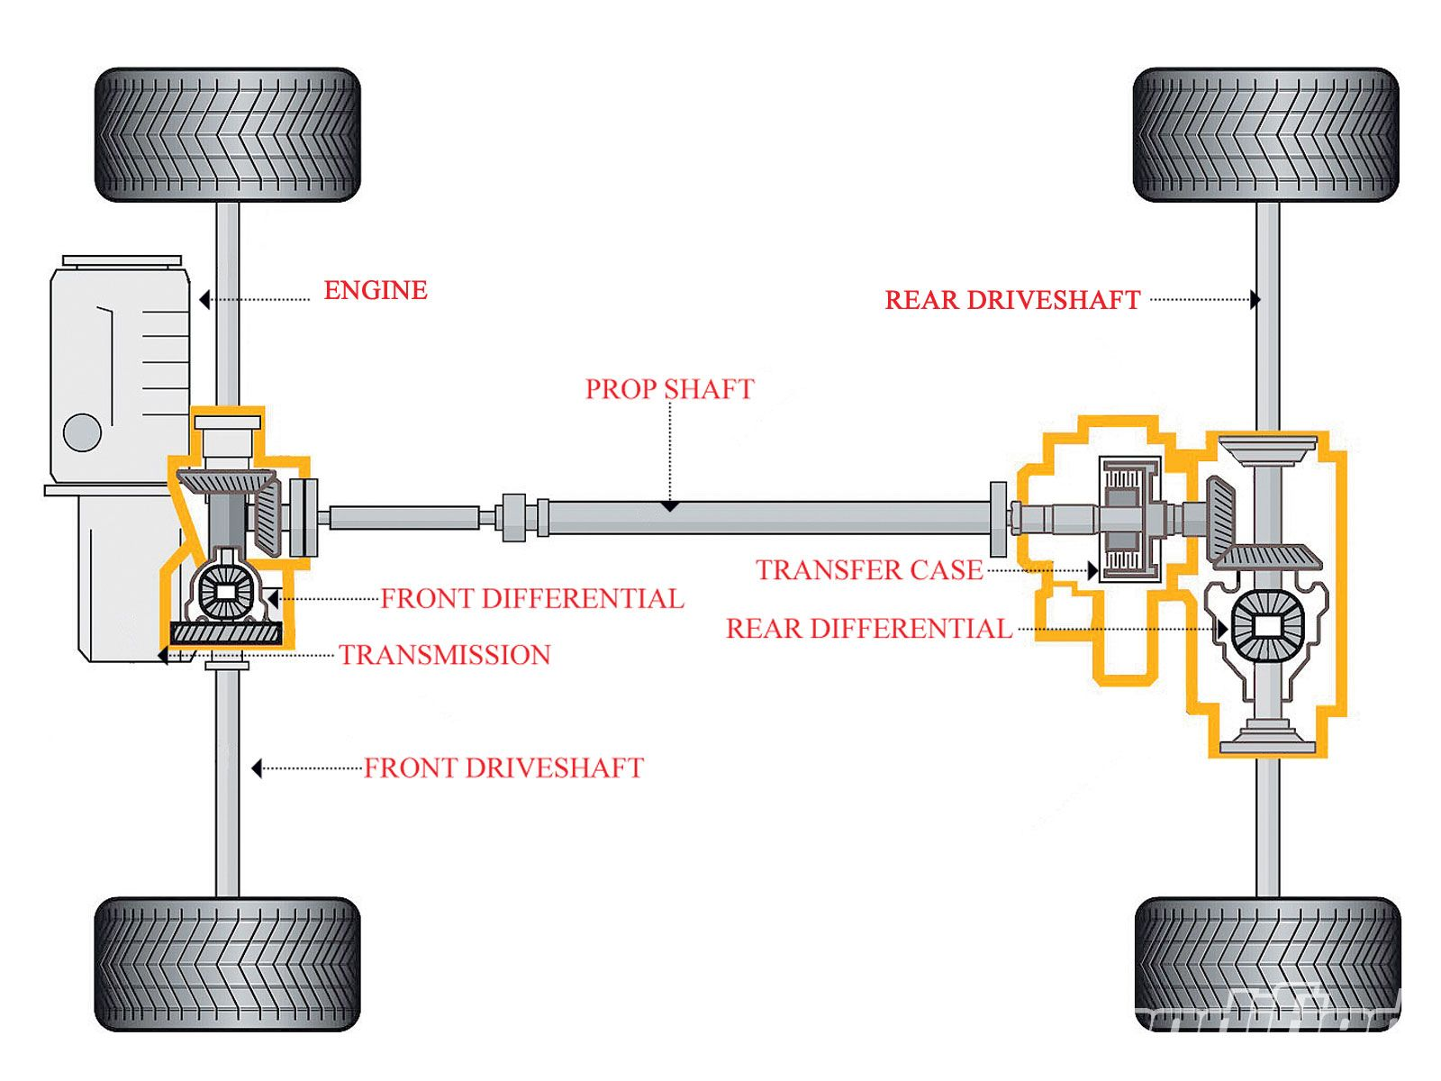
Then while using the regenerative braking neglecting the drag the estimated amount of regeneration power=0.1047*T*N
Where T-Load torque
N-RPM of the motor
This will lead to a calculated amount of 70% of the kinetic energy being recovered .
This Photo by Unknown Author is licensed under CC BY-SA

Slide 12
5. EXHAUST GAS ENERGY RECOVERY UNIT:
The fuel burned will not be completely utilised by the vehicle due to mechanical friction other factors . So the rest of the fuel that’s burned but not utilised by the vehicle are exhaust gas which need to be released from the engine for the engine to be restrained from any malfunction . This gas reaches a very high temperatures causing the molecules from gas to be extremely vigorous. This stream of gas could be targeted at a turbine for producing electricity using the generator . This faces an obvious problem of heating of the mechanical and electrical parts . This needs to be countered using sufficient cooling and lubrication of the parts of the generator , engine , exhaust unit such as cooling using the radiators and through aerodynamic designing . A typical vehicle puts through about 30% of it’s fuel energy through the exhaust system . The amount of gas flowing relative to different engine operating condition:1 fuel mass flow=4*rpm/60(mg/s).

Slide 13
6. PEOPLE’S SUPPORT:
The modern vehicles are around 40% efficient in the usage of fuel so
by using this system 75% efficiency of the fuel can be attained .
More Sustainable :
a) There are over 1.2 billion combustion cars on the road , i.e the
estimated amount of Internal combustion engine (ICE) in
percentage is about 90% .This can help reduce the consumption
of the fossil fuels.
b) Less carbon foot print .
c) Less Fuel consumption. ie , it improves MPG rating .
Hyper car need not to be entirely electrical nor traditional
combustion engine hence it could utilize both technologies . It is
beneficial by using instant torque of the electrical power unit and
raw power of combustion engine .

Slide 14
7.COST ESTIMATION :
It is a complex engineering system hence high maintenance is required.
Due to the large number of components requirement the cost of manufacturing is high but in the long run it’s more profitable.
Better aerodynamic designing with very low drag coefficient could be well profitable for user.

Slide 15
9.REFERENCES :
Youtube channel: Skill lync-MATLAB
https://www.mathworks.com
https://www.sciencedirect.com
https://e360.yale.edu

Slide 16
VOTE OF THANKS :
We thank all the faculties and judges for supporting and mentoring us.
We also thank all the volunteers for their services and commitment.
Thank you to ULCCS,QL10 and IEEE SB CEV for this wonderful opportunity.

